Slide 1

netkit lab
Università degli Studi Roma Tre
Dipartimento di Informatica e Automazione
Computer Networks Research Group
Dos sistemas
Version | 2.2
Author(s) | G. Di Battista, M. Patrignani, M. Pizzonia, M. Rimondini, traducción J.M. San José
E-mail | contact@netkit.org
Web | http://www.netkit.org/
Description | Como poner en marcha y gestionar dos máquinas virtuales

Slide 2
copyright notice
All the pages/slides in this presentation, including but not limited to, images, photos, animations, videos, sounds, music, and text (hereby referred to as “material”) are protected by copyright.
This material, with the exception of some multimedia elements licensed by other organizations, is property of the authors and/or organizations appearing in the first slide.
This material, or its parts, can be reproduced and used for didactical purposes within universities and schools, provided that this happens for non-profit purposes.
Information contained in this material cannot be used within network design projects or other products of any kind.
Any other use is prohibited, unless explicitly authorized by the authors on the basis of an explicit agreement.
The authors assume no responsibility about this material and provide this material “as is”, with no implicit or explicit warranty about the correctness and completeness of its contents, which may be subject to changes.
This copyright notice must always be redistributed together with the material, or its portions.

Slide 3


Único sistema
Una red simple con dos sistemas conectados en el mismo dominio de colisión
eth0
pc1
10.0.0.1/24
eth0
Dominio de colisión 0
pc2
10.0.0.2/24
10.0.0.0/24

Slide 4
Paso 1 – creando las vms
Máquina anfitrión
user@localhost:~$ vstart pc1 --eth0=A
============= Starting virtual machine "pc1" =============
Kernel: /home/user/netkit2/kernel/netkit-kernel
Modules: /home/user/netkit2/kernel/modules
Memory: 8 MB
user@localhost:~$ vstart pc2 --eth0=A
============= Starting virtual machine "pc2" =============
Kernel: /home/user/netkit2/kernel/netkit-kernel
Modules: /home/user/netkit2/kernel/modules
Memory: 8 MB
pc1 se crea y una ventana de consola se abre para pc1
pc2 se crea y una ventana de consola se abre para pc2

Slide 5
Paso 2 – configurando interfaces de red
pc1
pc1:~# ifconfig eth0 10.0.0.1 netmask 255.255.255.0 broadcast
10.0.0.255 up
pc1:~#
pc2
pc2:~# ifconfig eth0 10.0.0.2 netmask 255.255.255.0 broadcast
10.0.0.255 up
pc2:~#

Slide 6
Paso 3 – ping
pc1
pc1:~# ping 10.0.0.2
PING 10.0.0.2 (10.0.0.2) 56(84) bytes of data.
64 bytes from 10.0.0.2: icmp_seq=1 ttl=64 time=2.65 ms
64 bytes from 10.0.0.2: icmp_seq=2 ttl=64 time=0.357 ms
64 bytes from 10.0.0.2: icmp_seq=3 ttl=64 time=0.380 ms
64 bytes from 10.0.0.2: icmp_seq=4 ttl=64 time=0.349 ms
64 bytes from 10.0.0.2: icmp_seq=5 ttl=64 time=0.348 ms
--- 10.0.0.2 ping statistics ---
5 packets transmitted, 5 received, 0% packet loss, time 4078ms
rtt min/avg/max/mdev = 0.348/0.818/2.656/0.919 ms
pc1:~#
pc1 y pc2 pueden alcanzarse mutuamente

Slide 7
Paso 4 – una mirada a los paquetes
Veamos los paquetes intercambiados en el dominio de colisión A
Se usa tcpdump, un analizador que muy usado en linux
Número de bytes capturados por paquete (el defecto es 88)
TCPDUMP(8) TCPDUMP(8)
NAME
tcpdump - dump traffic on a network
SYNOPSIS
tcpdump [ -AdDeflLnNOpqRStuUvxX ] [ -c count ]
[ -C file_size ] [ -F file ]
[ -i interface ] [ -m module ] [ -r file ]
[ -s snaplen ] [ -T type ] [ -w file ]
[ -E spi@ipaddr algo:secret,... ]
Guarda los paquetes en un fichero

Slide 8
Paso 4 – ping
Ping desde pc1
pc1
pc1:~# ping 10.0.0.2
PING 10.0.0.2 (10.0.0.2) 56(84) bytes of data.
64 bytes from 10.0.0.2: icmp_seq=1 ttl=64 time=6.94 ms
64 bytes from 10.0.0.2: icmp_seq=2 ttl=64 time=0.906 ms
64 bytes from 10.0.0.2: icmp_seq=3 ttl=64 time=0.864 ms
--- 10.0.0.2 ping statistics ---
3 packets transmitted, 3 received, 0% packet loss, time 2033ms
rtt min/avg/max/mdev = 0.864/2.906/6.948/2.858 ms
pc1:~#

Slide 9
Paso 4 – una mirada en los paquetes
Al mismo tiempo capturamos en pc2 (ctrl-C para terminar)
pc2
pc2:~# tcpdump -i eth0
tcpdump: verbose output suppressed, use -v or -vv for full protocol decode
listening on eth0, link-type EN10MB (Ethernet), capture size 96 bytes
19:27:17.899782 arp who-has 10.0.0.2 tell 10.0.0.1
19:27:18.002578 arp reply 10.0.0.2 is-at fe:fd:0a:00:00:02
19:27:18.004384 IP 10.0.0.1 > 10.0.0.2: icmp 64: echo request seq 1
19:27:18.005806 IP 10.0.0.2 > 10.0.0.1: icmp 64: echo reply seq 1
19:27:18.920463 IP 10.0.0.1 > 10.0.0.2: icmp 64: echo request seq 2
19:27:18.920605 IP 10.0.0.2 > 10.0.0.1: icmp 64: echo reply seq 2
6 packets captured
6 packets received by filter
0 packets dropped by kernel
pc2:~#

Slide 10
Paso 4 – mirando los paquetes con el interfaz gráfico
Del mismo modo que en el caso anterior pero guardando los paquetes capturados en el fichero capture.pcap (en la máquina)
  El directorio (real) del usuario está disponible dentro de la vm bajo el directorio /hosthome
pc2
pc2:~# tcpdump -i eth0 -w /hosthome/capture.pcap
tcpdump: listening on eth0, link-type EN10MB (Ethernet), capture
size 96 bytes
10 packets captured
10 packets received by filter
0 packets dropped by kernel
pc2:~#

Slide 11
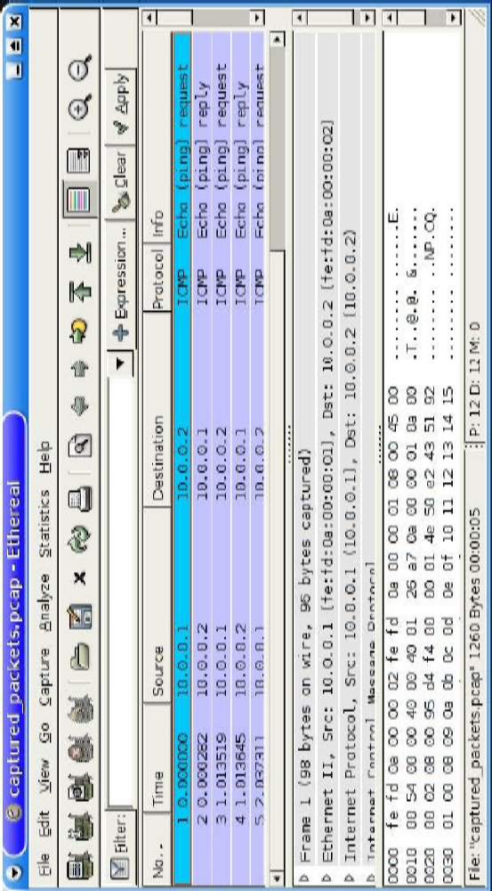
Paso 4 – mirando los paquetes con el interfaz gráfico
Abrir capture.pcap en el sistema real usando un analizador de paquetes (como ethereal)

